Slide 1

Where We’ve Been and Where We’re Heading!
Co-Chairs:
Cathy van Soest & Doug Holmes

Slide 2
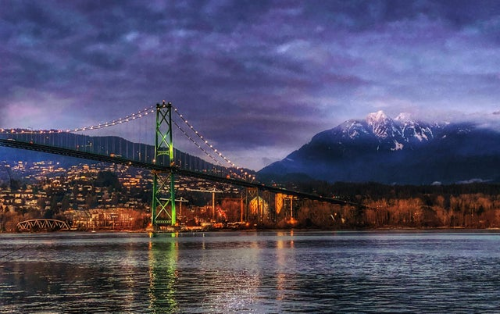
Agenda
Introductions
A brief history of CanPESC
Recent initiatives and accomplishments
Future directions
Image Credit

Slide 3
Glossary of Common Terms
AACRAO – American Association of Collegiate Registrars and Admissions Officers
CanPESC – Canadian PESC User Group
CDL – Common Digital Layout
CSS – Cascading Stylesheet (.css file)
CSV – Comma Separated Values (.csv file)
EDI – Electronic Data Interchange
EDX – Electronic Data eXchange
GEO Code – PESC Global Education Organization Code
HS – High School

Slide 4
Glossary of Common Terms
JSON – JavaScript Object Notation
JSON-LD – JSON for Linked Data
PDF – Portable Document Format (.pdf file)
PESC – Postsecondary Electronic Standards Council
PSI – Postsecondary Institution
SPEEDE – Standardization of Postsecondary Education Electronic Data Exchange
XML – eXtensible Markup Language (.xml file)
XSD – XML Schema Definition (template) (.xsd file)
XSLT – eXtensible Stylesheet Language Transformation (.xsl file)
WG – Work Group

Slide 5



A brief history of CanPESC
Late 1980’s
Task Force
Early 1990’s until today
SPEEDE Committee
1997
Established
2011
CanPESC launched
Canadian Member Slot ¹
CanPESC
Liaison
1990’s – 2001
EDI Task Force
2013
MOU
2014
discuss
GDN
2016
GDN Project
2020 MyCreds

Slide 6
Data exchange bridges built along the way!
2003 – 2014 (EDI)
2014 (XML)
PSI Transcript/Acks
(BC to ON)
2021 (XML)
HS Transcript/Req
(BC to ON)
CanPESC
Liaison
2022 (XML)
HS Transcript/Req
(BC to AB)
* Additional HS Transcript exchanges with SK, AB, ON, NS in discussion

Slide 7
October 2022 Convening
CanPESC Day
Hybrid, full day of discussions
PESC October Summit
1-day general sessions (in person)
1.5-day breakout sessions (hybrid)
Program

Slide 8
CanPESC: Recent initiatives & accomplishments
Standards of Practice: “Tip Sheet” v1.0
Data, process, policy and governance
Common Digital Layout: Operational!
GEO Code: ~50% Canadian High Schools Codified!
BC, ON and NS (6 more underway)

Slide 9
CanPESC: Current directions
CDL: French labels
Standards Upgrade Pathway: White Paper
Hub and PSI perspectives (input appreciated!)
Resources
Standards Version Inventory, “How To’s” and more!
GEO Code: Additional High Schools and PSIs

Slide 10
PESC: Topic Highlights
Data and system challenges and opportunities
Equity, Diversity & Inclusion
Gender Identity
Skills-based learning, credentialling and hiring
GEO Code revitalization
JSON-LD Transcript and JSON-LD Task Force
Current focus is on HS Transcript (Iowa project)

Slide 11


Slide 12
if you’re interested in
joining
contact Cathy & Doug!

Slide 13


Thank You!
Cathy van Soest Director, Client Relations E: cathy.vansoest@educationplannerbc.ca | Doug Holmes Manager, eTranscripts E: doug@ouac.on.ca

